Slide 1

Recursion
By Georgi Stoimenov

Slide 2

Who am I?

Slide 3



What is actually a recursion?
Notes:
Recursion is the process a procedure goes through when one of the steps of the procedure involves invoking the procedure itself. A procedure that goes through recursion is said to be 'recursive'.
For instance, the procedure of unboxing the matroska dolls: unbox the biggest one then the smaller one inside then the smaller one and so on until the last one which can’t be unboxed is reached.

Slide 4

Recursion in programming is…
Notes:
Recursion in computer science is a method where the solution to a problem depends on solutions to smaller instances of the same problem (as opposed to iteration).The approach can be applied to many types of problems, and recursion is one of the central ideas of computer science.[
Recursion is important because it is close to many problem-solving paradigms. Recursive algorithms are well-known in sorting(some of the fastest known algorithms for sorting are recursive – quicksort and mergesort). Recursion is used to define tree-like data structures and also algorithms for them(iteration through every element in tree). Also implementing solutions of more ‘abstract’ problems – e.g. Tower of Hanoi, Three glasses problem etc.

Slide 5

The Fibonacci sequence - Demo
Click me!
Notes:
The Fibonacci sequence amazes us with it’s so called golden ratio and it’s presents in nature(and in us too).
Click the link for more info!

Slide 6

How it works?
Fib(4)
Fib(3)
Fib(2)
Fib(2)
Fib(1)
Fib(0)
Fib(1)
Fib(0)
Notes:
Basic concept of building the Fibonacci recursive tree.
How will the tree look like if we want to get the tenth element from the sequence?

Slide 7

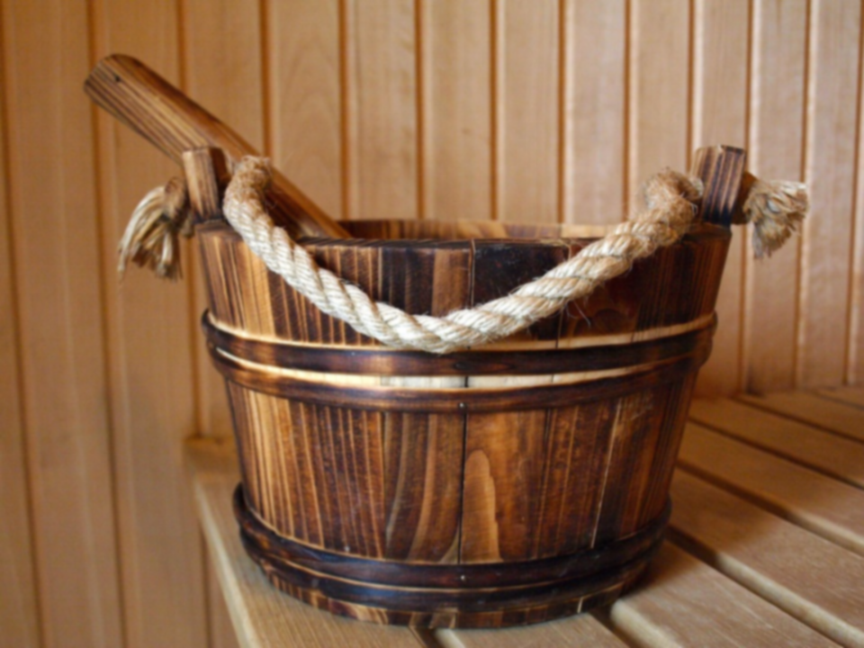

Specifics of the recursion
Bottom
Depth
Directions
Notes:
Bottom- end of recursion or widely known as a condition from which the function is not calling itself.
Depth – the level of “diving” into the recursion tree.
When the depth is the biggest?
Directions – straight and reverse. In most cases before hitting the bottom of the recursion is straight direction and afterwards is reverse direction.

Slide 8

Modified Fibonacci
private static long GetModifiedFibonacci(int n)
{
if (n <= 2)
{
return 1;
}
long result = 5;
result += GetModifiedFibonacci(n - 1) + GetModifiedFibonacci(n - 2);
result = result * n;
return result;
}
Straight move
Bottom
Backward move
Notes:
Example of the previous slide.

Slide 9


Recursion types
Direct
Indirect
Tail
Notes:
Direct – function calling itself directly.
Indirect – function calling itself(not directly) by using some sort of third-party function which calls the first one.
Tail – function that has nearly no reverse direction which it’s building it’s result before hitting the bottom of the recursion and after that directly returning the result.

Slide 10
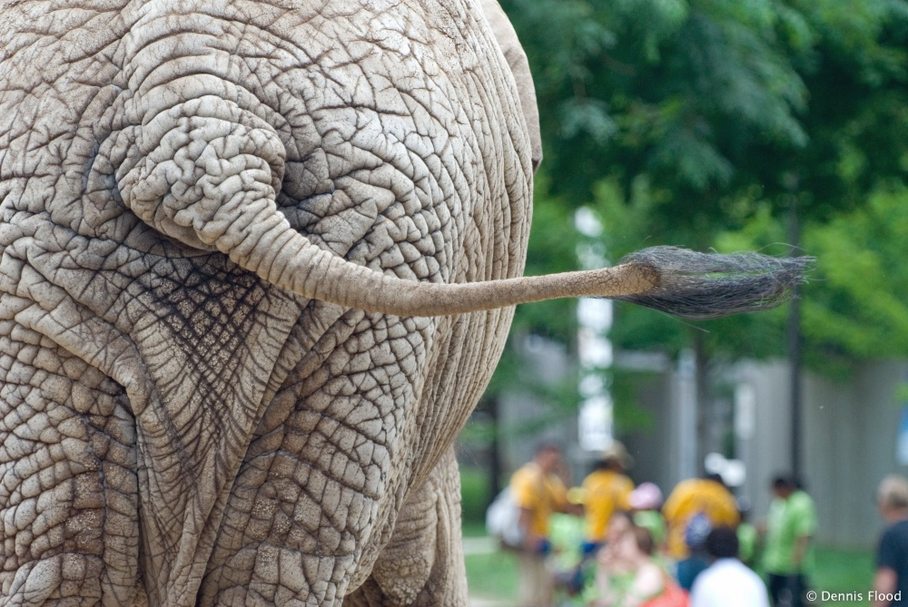
Demo: Tail recursion
This way
Yes, this is an elephant’s ass.
Notes:
Tail recursive factorial calculation.

Slide 11

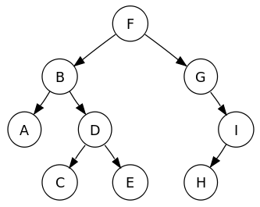
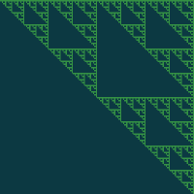

Recursive algorithms
Find path in labyrinth
Tree traversal
Click me!
Notes:
A common computer programming tactic is to divide a problem into sub-problems of the same type as the original, solve those sub-problems, and combine the results. This is often referred to as the divide-and-conquer method; when combined with a lookup table that stores the results of solving sub-problems (to avoid solving them repeatedly and incurring extra computation time), it can be referred to as dynamic programming or memoization.
Finding path in labyrinth is one of the easiest algorithms for the purpose.
Tree data structures are known as recursive data structures.
Drawing with recursion is applicable too!

Slide 12

What is the idea behind Recursion?
Notes:
Simplicity, effectiveness, elegance with power. This is how most of the recursive algorithms look like.
But like once was said : “With great power comes great responsibility”.

Slide 13

Is recursion always applicable?
Notes:
It's usually slower due to the overhead of maintaining the stack (when we use the system stack – which is pretty common practice).
May require more memory (because of stack).
When using big data or even bad algorithm
can cause StackOverflow Exception.

Slide 14

Conclusion
Notes:
Using recursion makes your code simple and understandable. It can be used to solve difficult tasks with ease.
However stepping out the boundary can make your algorithm slow and not effective.

Slide 15

Thanks for the attention!
https://goo.gl/cCwClG

